Slide 1
Common mistakes in
project proposals and final papers

Slide 2
1. You don't have a convincing reason of why doing X is important.

Slide 3
✘ I think it is important to protect red squirrels. (personal opinion without any supporting evidence)
✘ Red squirrels are important for the ecosystem, therefore we should protect red squirrels. (Still not enough objective evidence)
✔ Red squirrels are important for the ecosystem [1], but researches X, Y, and Z show that the quantity of red squirrels has declined for over 20% in the past 5 years [2], therefore we should protect red squirrels.

Slide 4
Real example:
On average, visa–free mobility has increased over the past 40 years [1]. However, not everybody has benefited from these developments. In fact, visa waivers are increasingly unequally divided: while citizens of OECD countries and rich countries have gained mobility rights, mobility rights for other regions have stagnated or even diminished, in particular for citizens from African countries [2]. Overall, we find a clear bifurcation in mobility rights, leading to a ‘global mobility divide'. So this piece of work aims to visualize the inequality of visa restrictions and how it is affecting the mobility of citizens of different countries [3].

Slide 5
2. You don't have studies and statistics to back up your arguments.

Slide 6
✘ The average income of NFL players has grown in the past 3 years.
✔ The average income of NFL players has grown by XXX% in the past 3 years (NFL statistics 2019).

Slide 7
Real example:
From the late 1990s, the deaths by opioids gradually increased and reached to 47,000
American deaths in 2017 (HHS.gov, 2019)
​

Slide 8
3. “I can’t find any relevant work!”

Slide 9
Fact: human beings have been doing stuff for over 2000 years. There will always be some kind of relevant work.

Slide 10
I want to make a map visualization of scooter vandalization in Bloomington.
✘ There is no existing work about scooter vandalization in Bloomington.
✔ Discuss visualizations about scooter vandalization in California.
✔ Discuss visualizations about bicycle vandalization.
✔ Discuss crime map visualizations for Bloomington.
✔ Discuss crime map visualizations for other cities (there should be many).
✔ Discuss scooter-related visualizations (there should be many)
✔ Discuss map visualizations of events (there should be thousands)

Slide 11
4. Graphs with no explanation

Slide 12
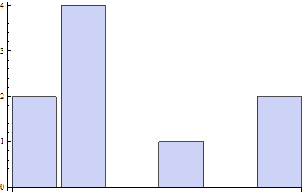

Slide 13
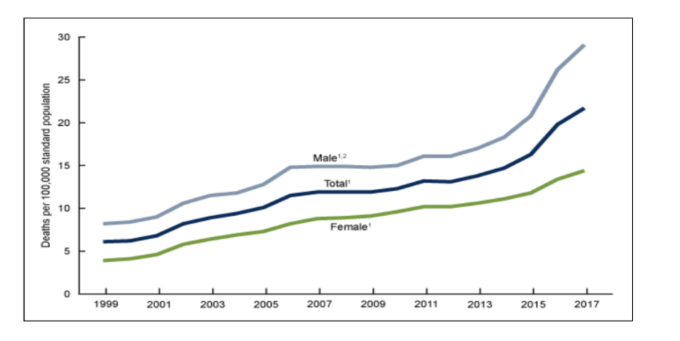
Real example:
A chart created by the CDC that plots the trend of male, female and combined (total) overdose deaths throughout the years (reproduced from [1]).

Slide 14
5. No description of the dataset

Slide 15
I will be using this dataset.

Slide 16
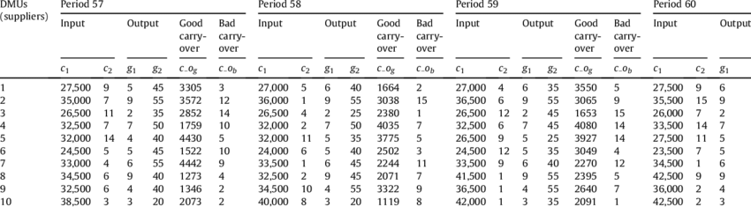
Dataset is incomprehensible without explanation

Slide 17
Real example:
In this dataset, each athlete has an ID. His or her name, gender, age, height, weight, team (which country does he or she compete for), sports she or he participated in, and the types of medal earned (gold, silver, bronze, or none) are listed.
For this investigation, I have isolated longitudinal data for deaths by the ICD-10 code for opioid deaths and compiled into a county-year panel. A single unit of observation in this data set is a county-year pair with the number of opioid deaths in that year, the county population, and the crude death rate per 100,000.

Slide 18
6. Bad citation formats

Slide 19
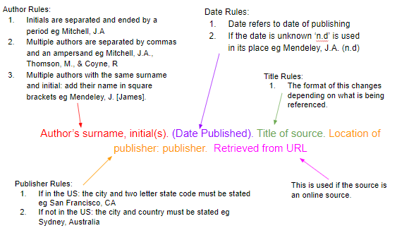
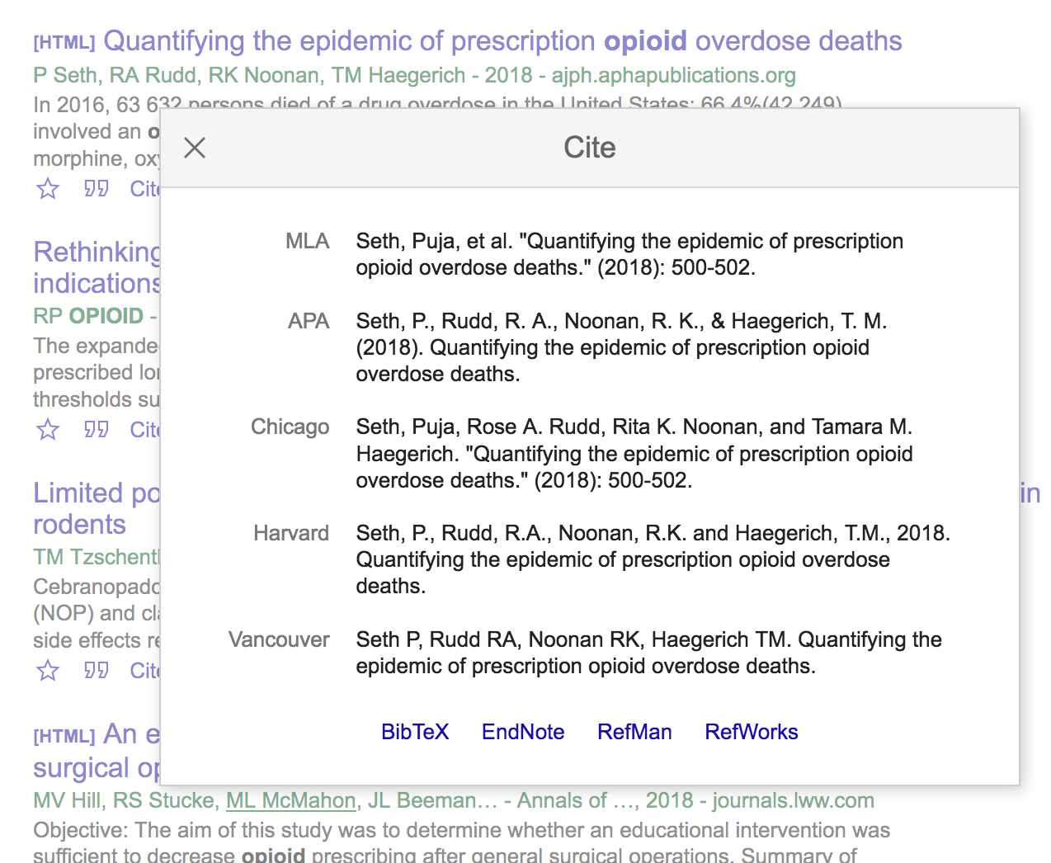
Easy citation generation using Google scholar

